Slide 1

INCOMING STUDENTS
GUIDE - FAU ENROLLMENT
FACULDADE DE ARQUITETURA E URBANISMO E DE DESIGN - INTERNATIONAL OFFICE

Slide 2
FAU USP DISCIPLINES
Exchange students (incoming) must enroll for FAU disciplines.
During the first two weeks of classes, incoming students can attend classes freely to see if they really want to take that discipline for the entire semester.
Tip:
Use these days to talk to the professors, check the discipline syllabus, and the calendar.
- Use these days to talk to other FAU students and ask for recommendations for professors and disciplines.
FACULDADE DE ARQUITETURA E URBANISMO E DE DESIGN - INTERNATIONAL OFFICE

Slide 3
FAU USP DISCIPLINES
When incoming students apply in the Mundus system, the list of disciplines that will be offered during the semester is not up to date at system.
For this reason, enrollment or pre-enrollment in the disciplines selected at the time of application is not carried out.
The only valid enrollment is the enrollment carried out in person at FAU, within the period determined for enrollment.
FACULDADE DE ARQUITETURA E URBANISMO E DE DESIGN - INTERNATIONAL OFFICE

Slide 4
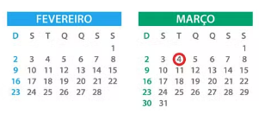
FAU USP DISCIPLINES
This is the calendar for the first weeks:
20/Feb – Welcome day
21/Feb – Giro USP
24/Feb – Start of Academic Semester
24 to 28/Feb – FAU Freshman reception
03 to 05/March – Carnaval holiday
06/March – Start of classes
10 to 14/March – FAU Enrollment (FAU Disciplines)
24 to 28/March – Period to exclude discipline
The USP Academic Year
2025
1st semester: 24/Feb – 07/Jul
2nd semester: 04/Aug – 12/Dec
FACULDADE DE ARQUITETURA E URBANISMO E DE DESIGN - INTERNATIONAL OFFICE

Slide 5
FAU USP DISCIPLINES
What are FAU disciplines?
All USP disciplines have codes. By looking at the codes, it is possible to verify which unit each discipline belongs to.
FAU-USP Disciplines:
FAU disciplines codes begin with the letters AU or number 16.
E.g.:
  AUT0512
  AUH0125
  AUP2424
  1610201
FACULDADE DE ARQUITETURA E URBANISMO E DE DESIGN - INTERNATIONAL OFFICE

Slide 6
FAU USP ENROLLMENT
Enrollment for incoming students is different from enrollment for regular students.
Enrollment period:
10 to 14/March/2025
Time:
08:30 a.m. to 10:30 a.m.
and
2:00 p.m. to 5:00 p.m.
Where: at the Serviço de Graduação, located on the 2nd floor
How: In person, by “Formulário de Matrícula”
FACULDADE DE ARQUITETURA E URBANISMO E DE DESIGN - INTERNATIONAL OFFICE

Slide 7
FAU USP ENROLLMENT
Some important rules
Vacancies
  The vacancies in the disciplines are filled in order of arrival / enrollment. If you wait to enroll on the last day, it is possible that there will be no vacancies for that discipline.
Disciplines “optativas” (the discipline code ends in an odd number (e.g. 1, 3, 5, ...)
  there is a limit of 10% of the total vacancies for enrollment of exchange students. Ex.: the discipline has 50 vacancies, a maximum of 5 exchange students can enroll.
  therefore, the exchange student may enroll in a maximum of 2 elective/”optativas” disciplines.
Disciplines “obrigatórias” (the discipline code ends in an even number (e.g. 0, 2, 4, ...)
  it will not be possible to choose the class for mandatory/”obrigatórias” disciplines
FACULDADE DE ARQUITETURA E URBANISMO E DE DESIGN - INTERNATIONAL OFFICE

Slide 8
FAU USP ENROLLMENT
Some important rules
How to search for discipline in the Jupiter system?
  Our office has created a step-by-step guide to help you with the discipline research process. Please read the material available on our website.
Repeated disciplines
  If you have already done an exchange program at FAU, the system does not allow you to enroll in a discipline that you have already completed previously. Except in cases where the student has failed that discipline.
To be approved in a USP discipline, the student must have at least:
  grade 5.0 (grades are counted from 0 to 10)
  class attendance above 75%
FACULDADE DE ARQUITETURA E URBANISMO E DE DESIGN - INTERNATIONAL OFFICE

Slide 9
FAU USP ENROLLMENT
Some important rules
Overlapping hours
  It will not be possible to enroll in disciplines that have overlapping hours. E.g.: One discipline is from 08am-10am and another is from 9am-12am (on the same day). The student must choose one of them to enroll.
  The student can use MatrUSP to check whether there will be any overlap in schedules between disciplines.
After the enrollment period
  If your name is not on the discipline's attendance list, go immediately to the Serviço de Graduação.
Period to exclude discipline
  Students may request to withdraw their enrollment from a course during the period designated for this purpose. This request must be made at the “Serviço de Graduação”.
FACULDADE DE ARQUITETURA E URBANISMO E DE DESIGN - INTERNATIONAL OFFICE

Slide 10
DISCIPLINE ENROLLMENT
More information
FAUUSP Discipline
  More information is available on our webpage. We recommend that incoming students carefully read the information and guidelines provided.
ECA, EP or FFLCH Disciplines
  If you want to enroll in disciplines from ECA, Poli or FFLCH, visit our webpage where we have prepared all the instructions for enrolling in these subjects
Disciplines from other USP units
  If you want to enroll in disciplines from other USP unit, you should send an email to our International Office (incoming.fau@usp.br) during the 1st week of academic semester, informing the discipline code and class in which you wish to enroll.
FACULDADE DE ARQUITETURA E URBANISMO E DE DESIGN - INTERNATIONAL OFFICE

Slide 11
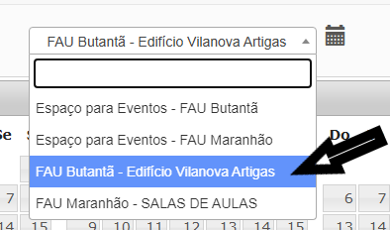
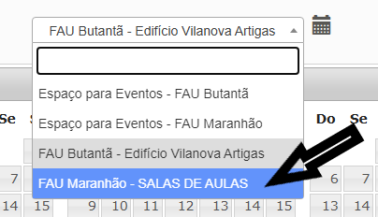
FAU CLASSROOM
Site “Reserva de Salas”
  Students can find where the class will be held on the “Reserva de Sala" website.
  On this website, reservations for all FAU classrooms are available, both in this building and in the building on Rua Maranhão (city center).
FACULDADE DE ARQUITETURA E URBANISMO E DE DESIGN - INTERNATIONAL OFFICE

Slide 12
USP CREDITS
The USP credit system does not follow ECTS credits, so the student must pay attention to the particularities of USP credits:
  Activities related to theoretical classes, seminars and practical classes have their value determined in “class credits”. Each class credit corresponds to 15 class hours.
  “Credit-work” is the value attributed to activities such as research planning, execution and evaluation; Field work; Scheduled readings,... The credit-work value corresponds to 30 hours.
Students must contact their home institutions to define:
  the minimum number of credits they must take in the semester and
  which form of conversion of USP credits will be adopted.
FACULDADE DE ARQUITETURA E URBANISMO E DE DESIGN - INTERNATIONAL OFFICE

Slide 13

Thank you
We hope that the instructions and information provided in this guide have answered your questions about enrolling in FAU disciplines!
If you have any questions that are not covered here, please contact us:
email: international.fau@usp.br/incoming.fau@usp.br
FACULDADE DE ARQUITETURA E URBANISMO E DE DESIGN - INTERNATIONAL OFFICE

